Slide 1
Photovoltaic's / Solar Photovoltaic Systems (SPV)
Solar photovoltaic system enables direct conversion of sunlight into electricity and is a viable option for lighting purpose in remote non-grid areas.
The common SPV lighting systems are:
Solar lantern,
Fixed type solar home lighting system, and
Street lighting system
SPV lighting system should preferably be provided with CFL for energy efficiency.
Inverters used in buildings for supplying electricity during the power cut period should be charged through SPV system.
Regular maintenance of SPV system is necessary for its satisfactory functioning.
Lighting shelves and light pipes may be explored

Slide 2
Solar Photovoltaic Power Generating System
Solar energy, which is available in two forms, heat and light, is a renewable and inexhaustible natural resource and can supplement/augment the depleting fossil fuel resources.
Greenhouse gases and pollutant emissions which result from fossil fuel generation can also be offset by solar photovoltaic power generation.
Most parts of the country receive good solar radiation of 4 to 7 kWh/m2 per day and almost 300 sunny days in a year making solar PV system one of the most preferred renewable energy source in the country.

Slide 3
Solar PV power generating system consists of components and subsystems that are used to convert incident solar radiation directly into electrical energy.
The energy converter (namely, solar photovoltaic cells which convert solar energy directly into d.c. electric power) does not have moving parts and has a comparatively long lifetime. Also, it can be used in decentralized/distributed mode.
PV cells are made of light-sensitive semiconductor materials that use photons to dislodge electrons to drive an electric current.
Individual PV cells are interconnected to form a PV module. This takes the form of a panel for easy installation.
Most solar PV systems can be mounted on a building or installed on ground. For buildings, they are either mounted on the roof or integrated into the building facade (BIPV).

Slide 4
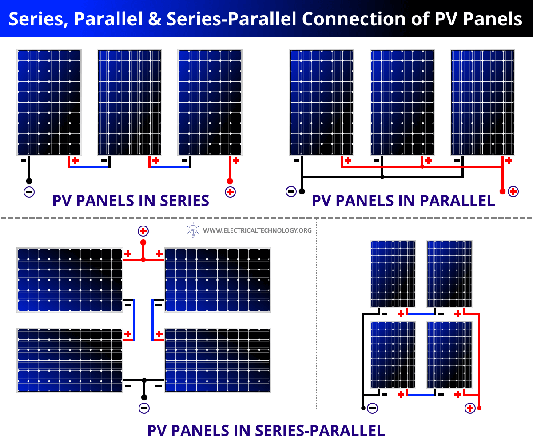

Slide 5
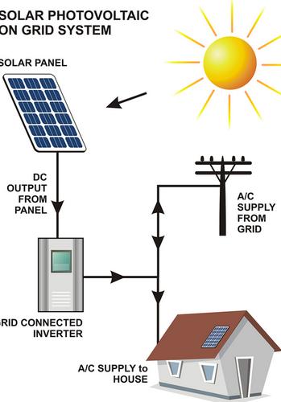
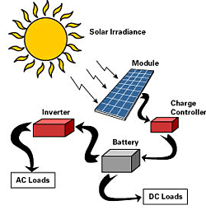
Types of Solar PV Generating System
When photovoltaic modules are exposed to sunlight, they generate electricity in d.c. waveform. The PV power generating systems can broadly be classified into two categories, namely, stand-alone (with a.c. output or with d.c. output) and grid connected system.
Stand alone solar PV system
Grid connected solar PV system

Slide 6
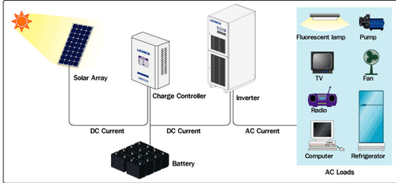
Stand alone solar PV system
Stand alone solar PV generating system is an independent power production system that is not connected to the grid and can thus be designed free from grid code requirements. This system is also known as off-grid system.

Slide 7
Off-grid solar PV systems are applicable for areas where there is no available power grid, such as remote villages, forests, off-shore islands, ships.
But they may also be installed within the city in situations where it is inconvenient or too costly to tap electricity from the power grid.
An off-grid solar PV system needs deep cycle rechargeable batteries, such as lead-acid, nickel- cadmium or lithium-ion batteries to store electricity

Slide 8
Grid connected solar PV system
A grid connected solar PV generating system is interconnected with an existing electric power grid, subject to grid requirements.
This system is also known as grid-tied system.
A building has two parallel power supplies, one from the PV solar system and the other from the power grid.
The combined power supply feeds all the loads connected to the main a.c. distribution board.
Whenever the solar PV supply exceeds the buildings current demand, excess electricity is exported into the grid.

Slide 9
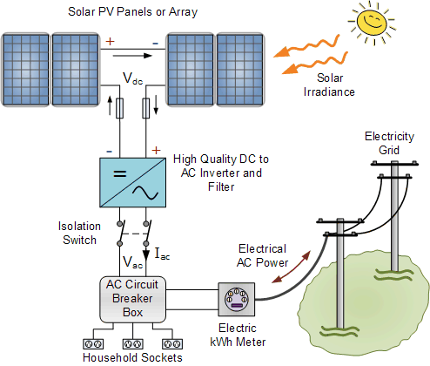

Slide 10
Components of solar PV systems and factors of performance are as follows:
PV modules: These contain solar cells. Efficiency of cells and module should be as high as possible. Currently, cells having 16 percent efficiency are commonly used and suggested.
Charge controller/inverter/PCU . It is part of PV system that matches the output of PV modules with acceptable form of electricity by battery bank or load or grid. Since considerable power loss may take place in this unit, efficiency of inverter/ PCU should be more than 90 percent at full load and not less than 85 percent at 25 percent load.
Battery bank . It is where energy can be stored in batteries for use during off- sunshine hours. If kept indoor, the space should be sufficiently ventilated with fresh air with no recirculation of air.

Slide 11
Rainwater Harvesting
To supplement the ever growing shortage of protected, pure and safe water supply for human consumption, rainwater is an ideal source which can be conserved and used in a useful manner by the people.
The amount of rainfall available varies from region to region.
Each area has to develop its own method and system to conserve, store and use it to suit its requirement and local conditions.
There are several methods by which rainwater can be stored, used and conserved.
Each system depends on the amount of precipitation, the period in which the rainfall occurs in a year and the physical infrastructure, for example space available to store the water, etc

Slide 12
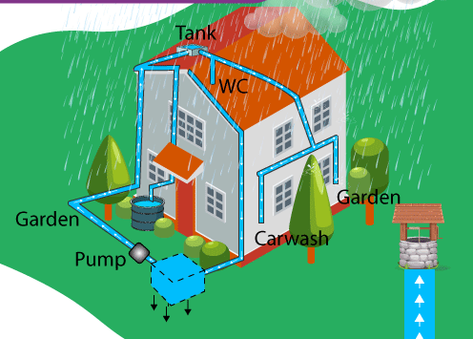
There are several techniques available for catching and storing the rainwater.
Most of the techniques are applicable for large open areas, farms, sloping grounds, etc, with a low population base.
Two major systems that are ideal for urban and semi-urban developed areas are:
Artificial ground water recharge, and
Roof top rainwater harvesting

Slide 13
Artificial ground water recharge:
With increase in the impermeable surfaces in modern built up areas, there is gross reduction in the original catchment area.
This prevents the natural percolation that would have recharged the area in the normal course if the ground was in its natural condition, for example a farm, open ground, forest, etc.
This results in a large quantity of water, normally percolating into the ground, running off to the natural drains and into the rivers, causing increased runoff and flooding of downstream areas.
It is therefore essential to catch the runoff and use it for augmentation of ground water reservoir by modifying the natural movement of surface water by recharging it by artificial means, for example construction of recharge structures

Slide 14
The main objectives achieved may be:
Enhancement of sustainable yield in areas where over development and depletion of the aquifers.
Conservation and storage of excess surface water in the aquifers.
Improve the quality of the existing ground water through dilution.
Remove bacteriological and suspended impurities during the surface water transition within the subsoil.
Maintain the natural balance of the ground water and its usage as the rainwater is a renewable supply source. A well managed and controlled tapping of the aquifers will provide constant, dependable and safe water supply.

Slide 15
Roof top rainwater harvesting
Harvesting in regular rainfall areas:
In areas having rainfall over a large period in a year, for example in hilly areas, coastal regions, etc constant and regular rainfall can be usefully harvested and stored in suitable water tanks.
Water shall be collected through roof gutters and down take pipes. Provision should be made to divert the 1st rainfall after a dry spell so that ant dust, soot and leaves, etc, are drained away before the water is collected into the water tank.
The capacity of the water tank should be enough for storing water required for consumption between two dry spells.
The water tank shall be located in a well protected area and shall not be exposed to any hazards of water contamination from any other sources.

Slide 16
The water shall be chlorinated using chlorine tablets or solution to maintain a residual chlorine of approximately 1 mg/l. The tank shall have an overflow leading to natural water courses or to any additional tanks.
Harvesting in limited rainfall areas:
In areas with the rainfall limited during the monsoon period (usually from 15-90 days), roof top rainwater can be stored and used for non-potable purposes, after proper treatment, in the premises itself as mentioned above; excess water, if any, is best used for recharging the ground water.
For individual properties and plots the roof top rainwater can be diverted to underground or above ground water storage tank(s), pretreated, stored and used for non-potable purposes.

Slide 17
Excess water, if any, may be discharged to existing open or abandoned tube wells. In a well-planned building complex, a system should be laid out so that the runoff is collected in underground or above ground water storage tank(s), pretreated, stored, and used for non-potable purposes.
Excess water, if any, shall be discharged in bore-wells as per designs specified by the Central Ground Water Board, Government of India.

Slide 18
Rainwater harvesting for plotted/group housing developments
The rainwater harvesting methods adopted for plotted and group housing are through collection of rooftop rainwater and surface runoff harvesting.
A network of storm water drains in the entire residential area is used for harvesting rooftop rainwater and surface runoff.
Appropriate number of recharge wells measuring 1 m × 1 m × 2 m may be constructed in the storm water drain for facilitating groundwater recharge.
The quality of runoff, which passes through the borewell installed inside the recharge well, is ensured through a filter bed of pebbles.

Slide 19
Other methods of rainwater harvesting:
Creation of artificial reservoirs/lakes for utilization of available storm water .
This shall be based on estimation of amount of runoff volume based on rainfall data (for a period of 10 years) considering the percolation and evaporation losses and efforts to be made to collect all available runoff for proper utilization.
Water balancing methods
This refers to optimum utilization of available water from different sources, namely ground water, recycled waste water, storm water and municipal supply and its adoption would ensure that there is no wastage of water.

Slide 20
Climate and Energy
Environmental impacts of generating energy from alternative sources constitute one dimension of the problem.
Four end-use activities- agriculture, transportation, housing and industry and concluded that ecological damage initiated by the end use to which energy is put is not negligible compared to direct ecological damage initiated by fuel combustion, effluents, mining of fuels and conversion.
Moreover, because the indirect impacts are independent of the type of energy supply, development of cheap, unlimited and clean source of energy is not the end of energy related environmental problems;
Generation of clean energy is one aspect of the environmental implications of energy use and unless equal emphasis is given to the pollution caused by actual consumption of energy, development of clean energy may mean fulfilling only half the mission of environmental friendliness.

Slide 21
Macro and Microclimate
The climate of the earth consists of a series of interlinked physical systems powered by the sun. In the built environment we are generally concerned with local climate systems in particular
Macro – climate: The climate of a larger area such as a region or a country
Micro- Climate: the variations in localized climate around a building
The macro and micro climate has a very important effect on both the energy performance and environmental performance of buildings, both in the heating season and summer.
The site and design of a building can have a profound effect upon the interaction between a building and its environment.
The building site affects exposure to the prevailing wind, the solar radiation the building receives, pollution levels, temperatures and rain penetration.

Slide 22
Site and Micro Climate:
The orientation of the building affects solar gains and exposure to the prevailing wind(Ventilation).
The location of neighboring trees and buildings affects the solar gains(shading) and wind patterns.
Neighboring trees and buildings also protect the building from driving rain.

Slide 23
MACRO CLIMATE
The macro climate around a building cannot be affected by any design changes, however the building design can be developed with a knowledge of the macro climate in which the building is located
General climatic data give an idea of the local climatic severity:
Seasonal accumulated temperature difference (degree day) are a measure of the outside air temperature, though do not account for available solar
Typical wind speeds and direction
Annual totals of global horizontal solar radiation
The driving rain Index (DRI) relates to the amount of moisture contained in exposed surfaces and will affect thermal conductivity of external surfaces
This metereological data gives a general impression of the climate at the site of a building and the building design can be planned accordingly.
However the building itself and surrounding geography will affect the local climate.

Slide 24
MICRO CLIMATE
The site of a building may have a many micro climates caused by the presence of hills valleys, slopes streams and other buildings
Micro Climate – Effect of local terrain and Buildings
Surrounding slopes have important effects on air movement, especially at the bottom of a hollow. In hollows air warmed by the rises upwards due to buoyancy effects(anabatic flow), to be replaced by cooler air drifting down the slope(katabatic flow).
The result is that valley floors are significantly colder than locations part way up the slope..
The most favorable location in a valley is known as thermal belt, lying just above the level to which pools of cold air build up, but below the height at which exposure to wind increases.

Slide 25
Buildings themselves create further micro- climates by shading the ground, changing wind flow patterns.
One example of how buildings affect the local climate is the heat island effect in large cities where the average temperature is higher than the surrounding area
Solar energy absorbed and re-emitted from building surfaces, pavements roads etc. creates a warming effect on the surrounding air
Also the large quantities of buildings break up the wind flow, reducing wind speeds and causing the warm air to remain stagnant in the city. This also causes increased pollution as well as temperatures.
The presence of local high rise buildings can degrade the local climate as wind speed at ground level can be significantly increased, while extensive shadows block access to sunlight for long periods, increasing space heating costs in surrounding buildings.

Slide 26
IMPROVING MICRO CLIMATE THROUGH DESIGN
The aim of enhancing micro climate around buildings:
Reduce costs of winter heating
Maximize outdoor comfort in summer and winter
Improve durability of building material (reduced rain penetration)
Provide a better visual environment in spaces around buildings
Encourage growth of plants
Discourage growth of mosses and algae
Facilitate open air drying of clothes

Slide 27
Enhancing the micro climate around a building include:
SOLAR ACCESS:
Allow maximum day light and maximum solar radiation into space and buildings;
shade space and window from prolonged exposure to summer sun
Protect space and windows from glare
Wind Protection:
Protect space and buildings from prevailing winds and cold
Prevent buildings and terrain features from generating turbulence
Protect spaces and buildings from driving rain and snow
Protect space and buildings from katabatic flows, while retaining enough air movement to disperse pollutants

Slide 28
FEATURES:
Provide thermal mass on moderate extreme temperatures
Use vegetation for sun shading and wind protection(transpiration helps moderate high temperatures)
Provide surfaces that drain readily
Provide water for cooling be evaporation (Pools and fountains)

Slide 29
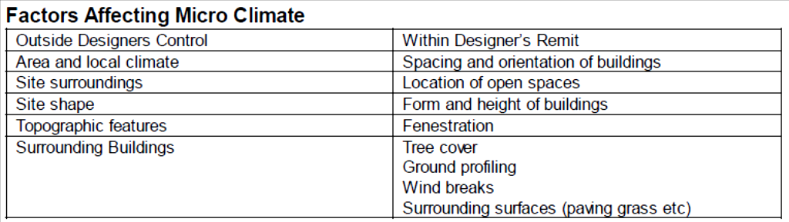

Slide 30
Two main possiblities for influencing micro climate are solar access and wind control:
Solar access:
Solar access to a site is often a case for minimizing solar overheating in summer while maximizing solar access during the winter
Buildings with a heating requirement should be orientated north south with maximum glazing on the south face.
Deciduous trees offer an excellent means of site shading, with shading being reduced in winter when the trees lose their leaves
Grass planted outside a building will reduce the ground reflected solar
Use of courtyards and water can also moderate the effects of high temperature on summer.

Slide 31
Wind control:
The form of the building can have a great effect on the impact of the wind:
Avoidance of the funnel like gaps between buildings
Avoidance of flat roofed buildings and cubical forms
Avoid abrupt changes in buildings heights
Orientate long axis of the building parallel to the direction of the wind
Use pitched rather than flat roofs and stepped forms for higher buildings
Coniferous trees and fencing and other landscape features such as mounds of earth and hedges can also reduce the impact of wind and driving rain on the building structure

Slide 32
Enhanced Micro climate and energy saving
Increased external air temperature leading to reduced space heating reduction
Increase solar access to site, wind protection, external thermal mass, quick drying surfaces.
Reduced air change rate, internal air movement and decreased external surface connective heat transfer; reduced pressure driven ventilation by wind protection.
Reduced moisture effects on fabric(wall); less wetting of fabric and energy loss due to evaporation form wet surfaces by protecting from driving rain and providing adequate surface drainage

